Slide 1


Slide 2

Product Release
PRESENTATION
GROUP 4 | Machine Learning, Robotics And Sensor Networks Summer School
08/2018

Slide 3
WHAT
IS
FEEDIE
?

Slide 4
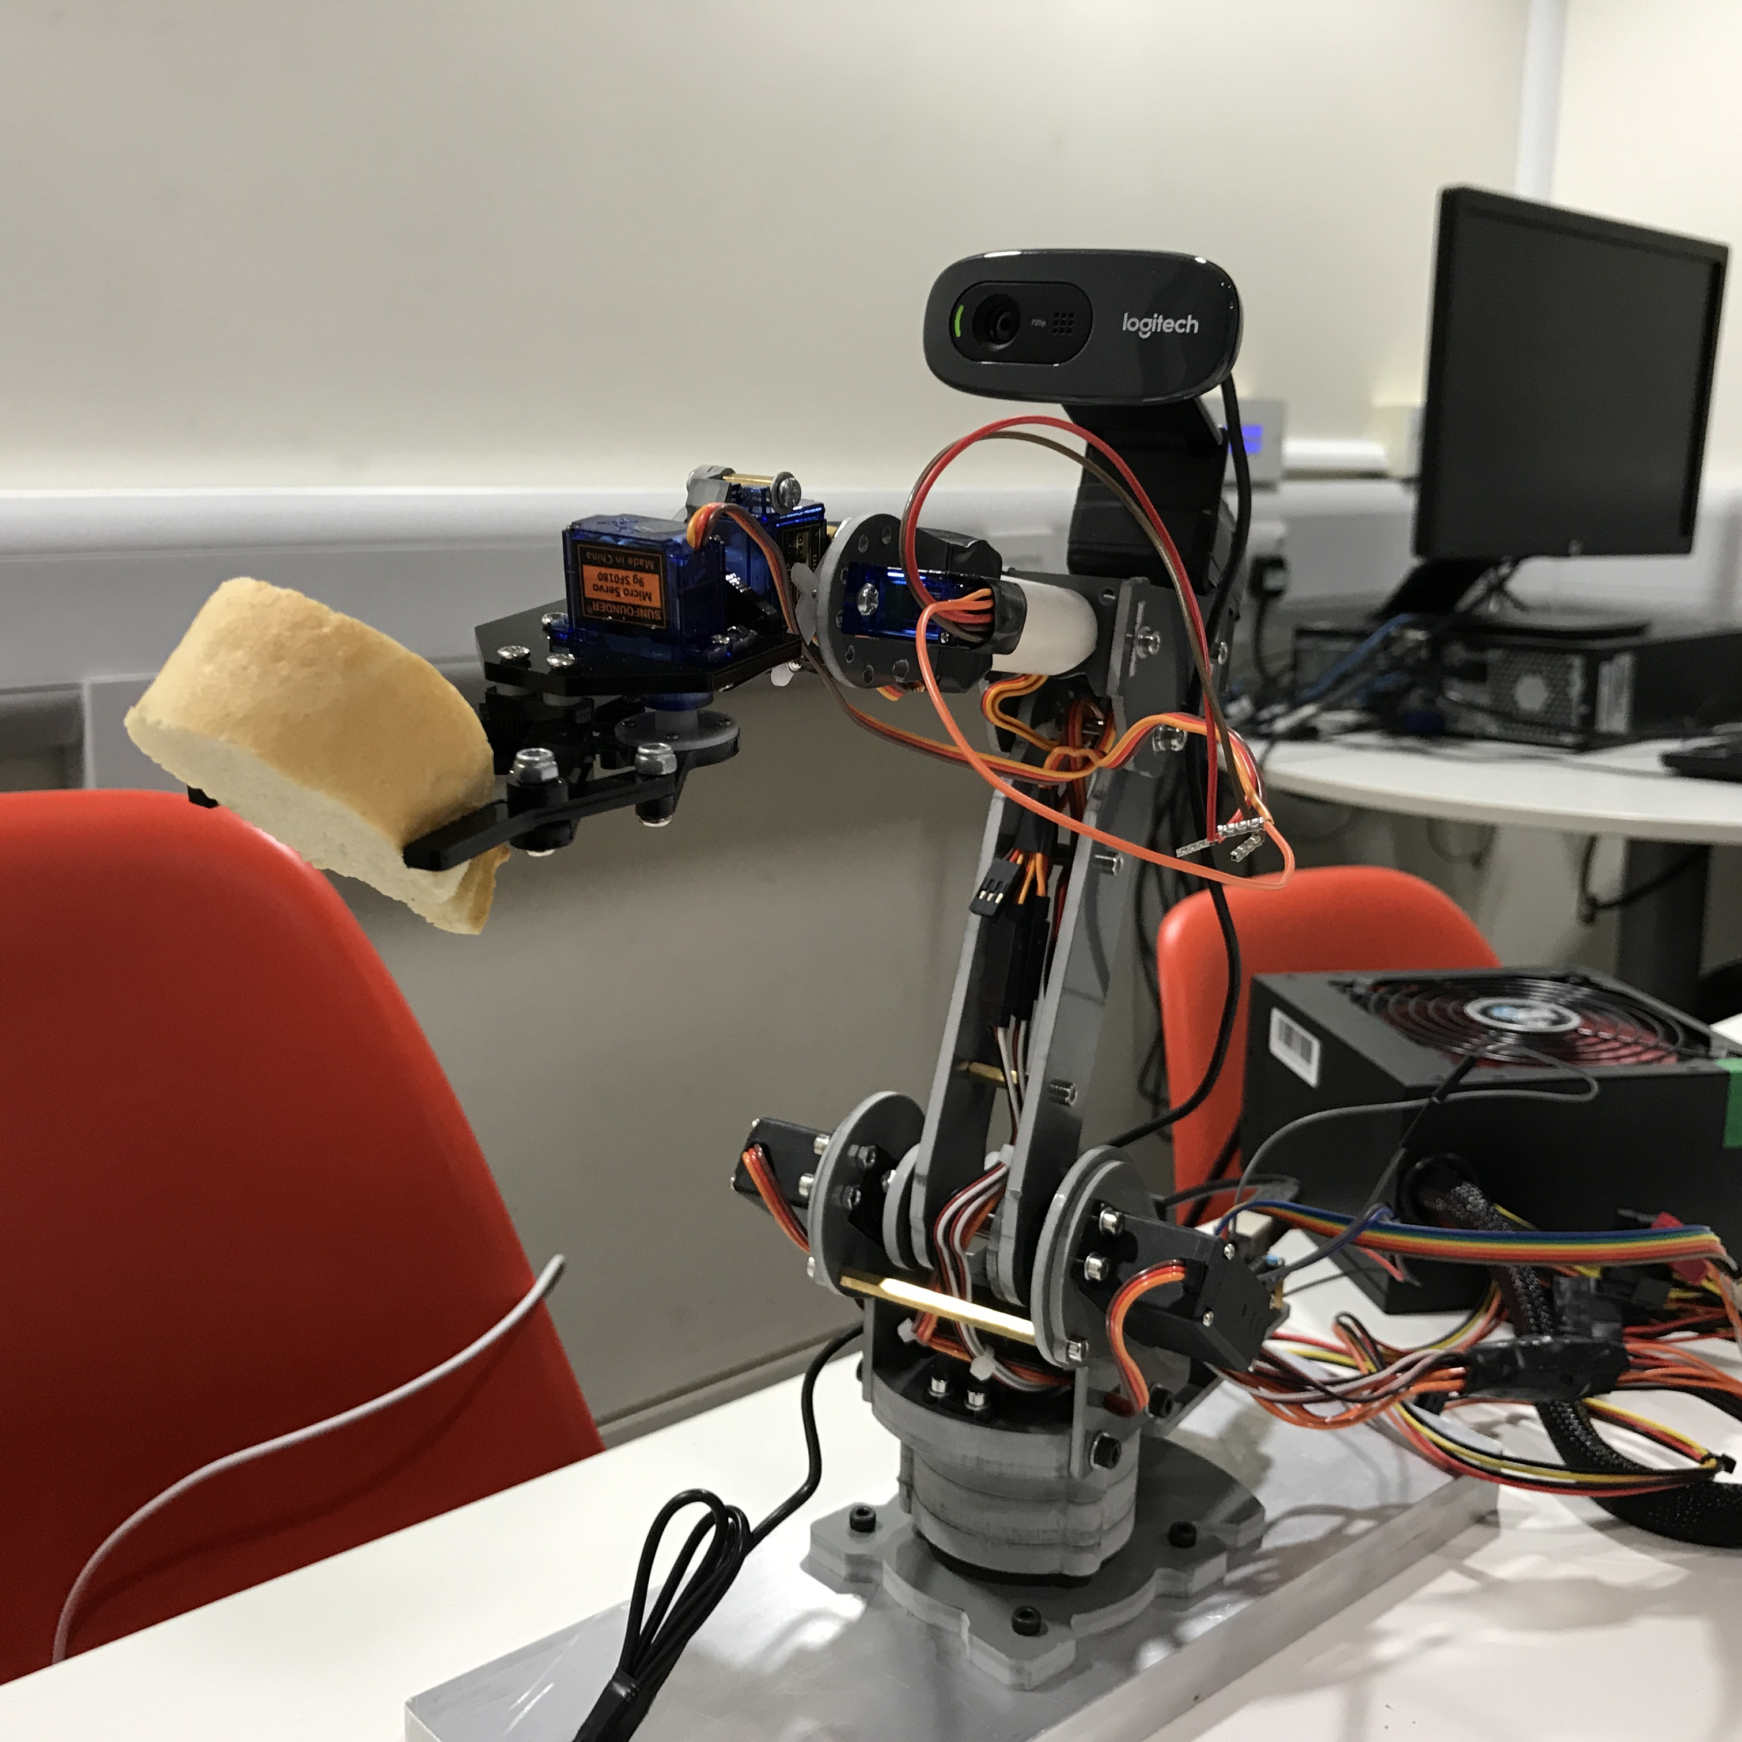
WHAT IS FEEDIE ?
FEEDIE is designed aiming at people who are unable to eat or drink independently.
User can control FEEDIE to fetch them food or drink by oral instructions.

Slide 5
WHAT IS FEEDIE ?
FEEDIE is designed aiming at people who are unable to eat or drink independently.
User can control FEEDIE to fetch them food or drink by oral instructions.
I FEED U EAT

Slide 6
WHAT IS FEEDIE ?
FEEDIE is designed aiming at people who are unable to eat or drink independently.
User can control FEEDIE to fetch them food or drink by oral instructions.
FEEDIE
START

Slide 7

CONTENT
Ⅰ
Ⅱ
INTRODUCTION
CORE TECHNIQUE
Ⅲ
Ⅳ
BUSINESS
POTENTIAL
TEAMWORK
GROUP 4 | Machine Learning, Robotics And Sensor Networks Summer School
08/2018

Slide 8
PART 2
CORE TECHNIQUE
GROUP 4 | Machine Learning, Robotics And Sensor Networks Summer School
08/2018
Ⅱ

Slide 9
Module Analysis

Slide 10
PART 2 CORE TECHNIQUE
Module Analysis
FEEDIE
Hardware
Robotic Arm, Arduino 101, Power Supply .etc.
Software
Front-End
Background
HCI
Speech Recognition
Image Recognition
Real-time
Video
GROUP 4 | Machine Learning, Robotics And Sensor Networks Summer School
08/2018

Slide 11
PART 2 CORE TECHNIQUE
Existing APIs
✘couldn’t response in time
↓
GMM-HMM & Random forest
✘could only classify some specific instructions
↓
An offline framework
& a natural language processing model
✓could extract keywords from natural language
Module Analysis
SPEECH
RECOGNITION
GROUP 4 | Machine Learning, Robotics And Sensor Networks Summer School
08/2018

Slide 12
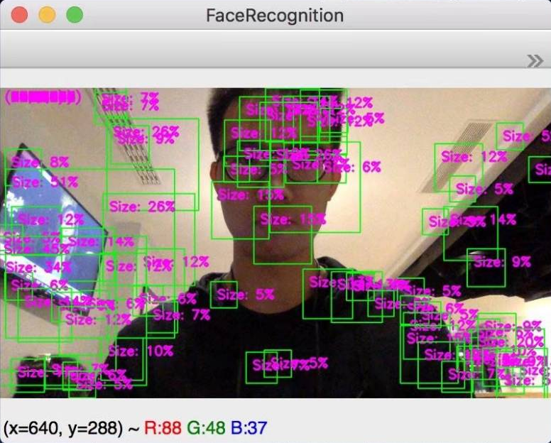
PART 2 CORE TECHNIQUE
OpenCV Classifier
✘couldn’t work very well
↓
CNN framework
✘hard to track the object
Module Analysis
IMAGE
RECOGNITION
GROUP 4 | Machine Learning, Robotics And Sensor Networks Summer School
08/2018

Slide 13
PART 2 CORE TECHNIQUE
OpenCV Classifier
1900 positive samples
4500 negative samples
10 layers
Module Analysis
IMAGE
RECOGNITION
Feedback mechanism of misjudgment
Reinforcement learning
GROUP 4 | Machine Learning, Robotics And Sensor Networks Summer School
08/2018

Slide 14
PART 2 CORE TECHNIQUE
Module Analysis
IMAGE
RECOGNITION
GROUP 4 | Machine Learning, Robotics And Sensor Networks Summer School
08/2018

Slide 15
PART 2 CORE TECHNIQUE
Module Analysis
FEEDIE
Hardware
Robotic Arm, Arduino 101, Power Supply .etc.
Software
Front-End
Background
HCI
Speech Recognition
Image Recognition
Real-time
Video
GROUP 4 | Machine Learning, Robotics And Sensor Networks Summer School
08/2018

Slide 16
PART 2 CORE TECHNIQUE
Module Analysis
FEEDIE
Front-End
Background
HCI
Speech
Recognition
Image
Recognition
Real-time
Video
Software
GROUP 4 | Machine Learning, Robotics And Sensor Networks Summer School
08/2018

Slide 17
PART 2 CORE TECHNIQUE
Module Analysis
Accuracy
Robustness
High
Efficiency
GROUP 4 | Machine Learning, Robotics And Sensor Networks Summer School
08/2018

Slide 18
PLENTIFUL IN IDEAL YET SKINNY IN REALITY
…

Slide 19
Problems And Solutions
Before: running for 30 hours by using the existing tool
Solution: recompiled the program, changed mononuclear into multinuclear
Be Creative
The complexity of training model: 1900 positive samples, 4500 negative samples, 10 layers

Slide 20
Before: used Baidu online speech recognition, required long time
Try: used GMM classifier to do the instruction classification, the outcome was unsatisfying
Solution: used Apple input method instead.
Learn to give up and simplify problems
Speech recognition

Slide 21
Face the difficulty bravely
To keep the cup balanced:
Worked out an algorithm step by step

Slide 22
Keep calm and
make the most of the resources at hand
Hardware: the board, power and motors burned a few days before presentation
Solution: bought a multimeter to debug
found an extra mechanical arm and used its components to reassemble our arm

Slide 23
PART 3
BUSINESS POTENTIAL
GROUP 4 | Machine Learning, Robotics And Sensor Networks Summer School
08/2018

Slide 24
Market Prospect

Slide 25
PART 3 BUSINESS POTENTIAL
Market Prospect
SOCIAL BACKGROUND
In 2016, the number of people over the age of 60 in China was 230.86 million, accounting for 16.7% of the national population. It is expected to reach 300 million by 2025.
A large number of nursing workers are required to provide services to help and care for the elderly and the disabled.
2016
230.86 million
16.7%
300 million
By 2025
Data source: Data analysis of China‘s service robot industry in 2016
GROUP 4 | Machine Learning, Robotics And Sensor Networks Summer School
08/2018

Slide 26
PART 3 BUSINESS POTENTIAL
Market Prospect
A feeding robot’s value:
For the other family members: Save time
For the disabled: More convenient
For hospitals: Save human resources
VS the existing technology: Cheaper
VS care worker: More economical
GROUP 4 | Machine Learning, Robotics And Sensor Networks Summer School
08/2018

Slide 27
PART 3 BUSINESS POTENTIAL
Market Prospect
Seize the opportunity
Survey Result （TOTAL: 157）
DIFFERENT OCCUPATIONS
DIFFERENT ECONOMIC STATUS
GROUP 4 | Machine Learning, Robotics And Sensor Networks Summer School
08/2018

Slide 28
Q2: Suppose that you or your family are not able to take care of your diet,
What do you think about a feeding robot fixed on the table?
SURVEY
Q1：Is there anyone in your
family who cannot take care of themselves?
GROUP 4 | Machine Learning, Robotics And Sensor Networks Summer School
08/2018

Slide 29
Competitive Advantages

Slide 30
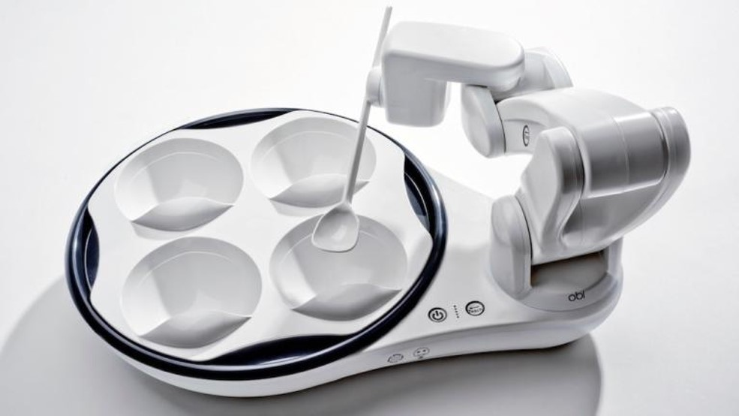
PART 3 BUSINESS POTENTIAL
Competitive Advantages
Competitors
OBI
A
STRENGTHS
Pioneer - the first feeding robot existing in the market
Simplification - simplify the model with the fixed plate and the easiest feeding tool (spoon)
B
WEAKNESSES
Lack of flexibility - cannot locate the position of the food and the user’s mouth automatically
Price - many families cannot afford this product
GROUP 4 | Machine Learning, Robotics And Sensor Networks Summer School
08/2018

Slide 31
PART 3 BUSINESS POTENTIAL
Competitive Advantages
Advantages of FEEDIE:
01
FEEDIE can recognize where the food (within its reach) is and reach it.
02
FEEDIE identify the user’s face and move the claw until it is in front of the mouth.
03
FEEDIE operates according to human’s oral order, realizing remote control.
GROUP 4 | Machine Learning, Robotics And Sensor Networks Summer School
08/2018

Slide 32
Marketing Approach

Slide 33
PART 3 BUSINESS POTENTIAL
Marketing Approach
TARGET USERS
SALES CHANNELS
KEY PARTERNERS
disabled
Babies or elderly
Online
Offline
Electronic business platforms, such as Suning and Jing Dong in China and Amazon abroad.
Advertising companies.
Housekeeping companies.
…
TARGET CUSTOMERS
KEY ACTIVITIES
individuals: home care
businesses: hospital, nursing home
Membership system.
Trial services
After-sales services
Complementary products
and services
GROUP 4 | Machine Learning, Robotics And Sensor Networks Summer School
08/2018

Slide 34
PART 4
TEAMWORK
GROUP 4 | Machine Learning, Robotics And Sensor Networks Summer School
08/2018

Slide 35
“Coming together is a beginning. Keeping together is progress.
Working together is success.”
------Henry Ford
WHAT MAKES A TEAM?
Information sharing
everyone makes a difference
Enjoy time together

Slide 36
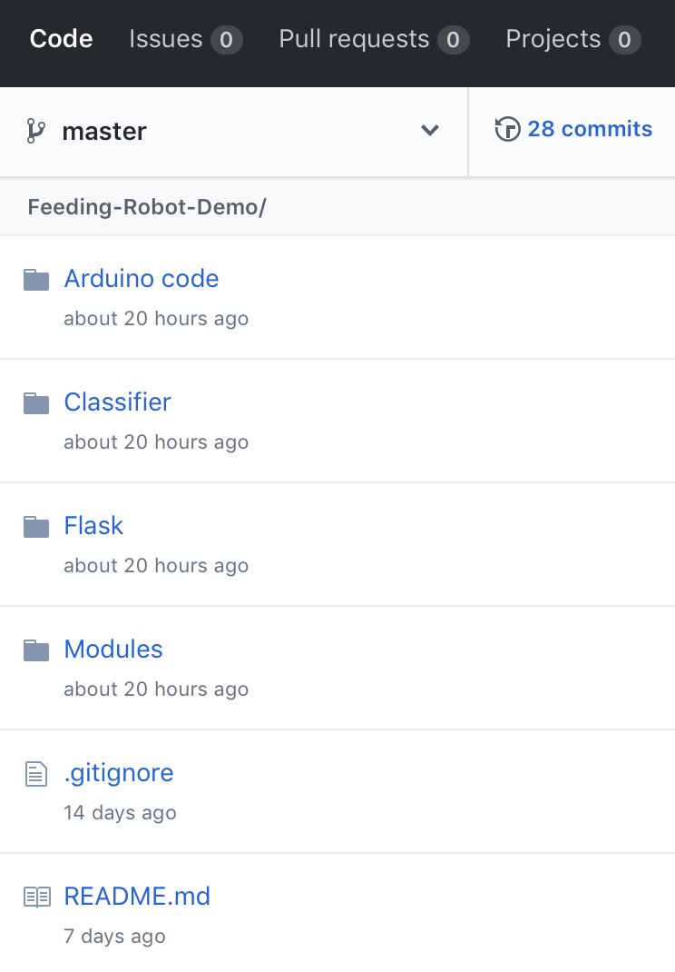
PART 4 TEAMWORK
Information Sharing
Sharing is one of the most important factors contributing to a successful teamwork.
GROUP 4 | Machine Learning, Robotics And Sensor Networks Summer School
08/2018

Slide 37
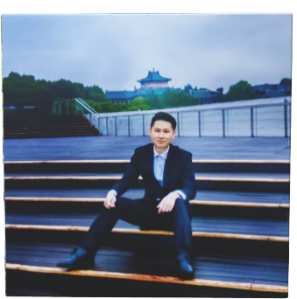
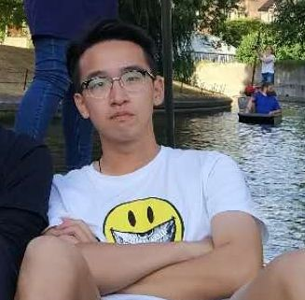
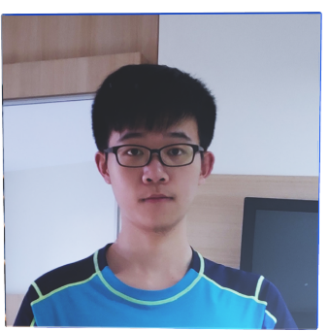
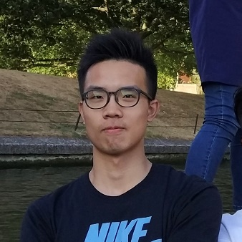
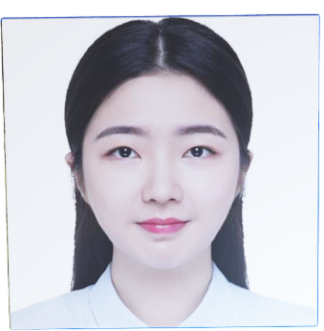
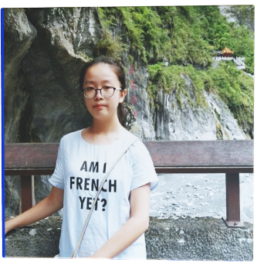
PART 4 TEAMWORK
Everyone has his/her own strengths
ZHENG SIYUAN
WUHAN UNIVERSITY
COMPUTER SCIENCE
2015
HE YUXUAN
WUHAN UNIVERSITY
ELECTRONIC ENGINEERING
2015
WU
YUHUI
HUAZHONG UNIVERSITY of S&T
ELECTRONIC INFORMATION
2015
LIU
YE
WUHAN UNIVERSITY
GEOGRAPHICAL SCIENCE
2016
ZHOU YUXUAN
WUHAN UNIVERSITY
ELECTRONIC ENGINEERING
2016
GU
YING
WUHAN UNIVERSITY
INFORMATION SECURITY
2016
GROUP 4 | Machine Learning, Robotics And Sensor Networks Summer School
08/2018

Slide 38

PART 4 TEAMWORK
Everyone has his/her own strengths
ZHENG
SIYUAN
WUHAN UNIVERSITY
COMPUTER SCIENCE
2015
HE
YUXUAN
WUHAN UNIVERSITY
ELECTRONIC ENGINEERING
2015
Leader, organize meetings to discuss the project, and divide the work.
Have learned a little bit about both hardware and software including python, arduino, etc.,
Main interests: computer vision and machine learning.
Rich project experience
Confident to speak in public, willing to cooperate, approachable
Time keeper, assist in software and hardware, contact supervisors
a)Have experience in computer vision and machine learning
b)Have basic python programming experience
c)have a good command of matlab
d)Good at communication
GROUP 4 | Machine Learning, Robotics And Sensor Networks Summer School
08/2018

Slide 39
PART 4 TEAMWORK
Everyone has his/her own strengths
WU
YUHUI
HUAZHONG UNIVERSITY of S&T
ELECTRONIC INFORMATION
2015
LIU
YE
WUHAN UNIVERSITY
GEOGRAPHICAL SCIENCE & COMPUTER SCIENCE AND TECHNOLOGY
2016
Chief hardware director
a)Strong ability in handwork
b)Careful and calm
c)Have basic knowledge about machine
Chief software programmer, assist in hardware
a)Have experience in machine learning and web framework
b)Strong ability in coding, wrote all the code for the project
c)Proficient in Python, JavaScript, C/C++, MATLAB, etc.
d)Able to work out various algorithms to realize certain expectations
GROUP 4 | Machine Learning, Robotics And Sensor Networks Summer School
08/2018

Slide 40
PART 4 TEAMWORK
Everyone has his/her own strengths
ZHOU
YUXUAN
WUHAN UNIVERSITY
ELECTRONIC ENGINEERING
2016
GU
YING
WUHAN UNIVERSITY
INFORMATION SECURITY
2016
Business planner, paperwork, responsible for safety
a)Minor in Finance, have basic knowledge about marketing
b)Good at English writing
Business planner, PPT designer
a)Have a good command of PhotoShop, PowerPoint and relative presentation tools
b)Good at English writing
GROUP 4 | Machine Learning, Robotics And Sensor Networks Summer School
08/2018

Slide 41
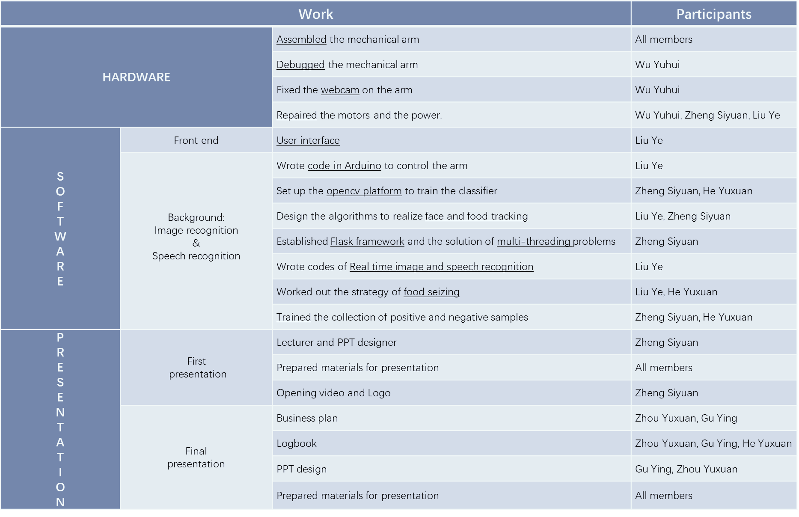
PART 4 TEAMWORK
Everyone makes a difference

Slide 42
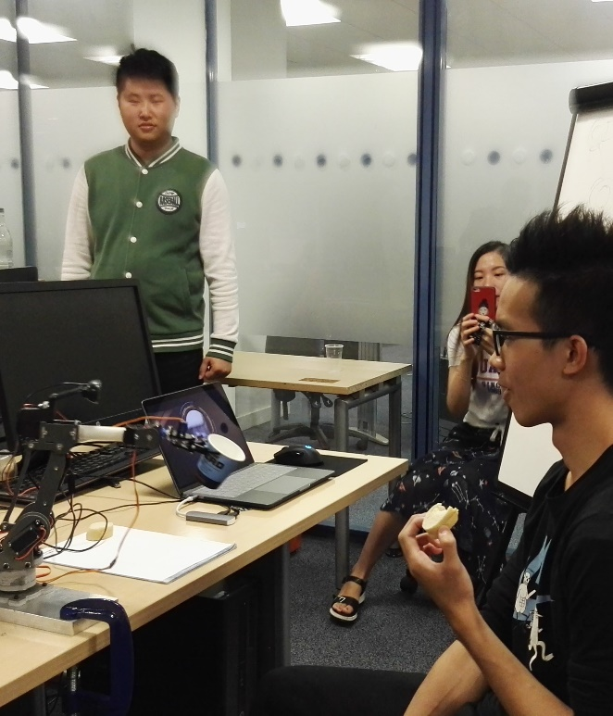
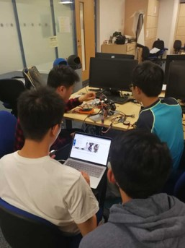
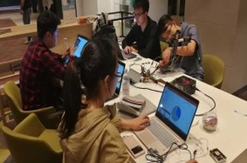
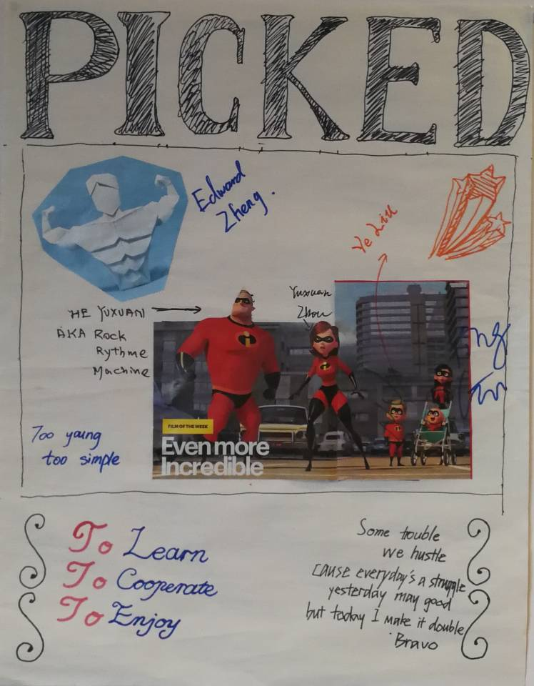
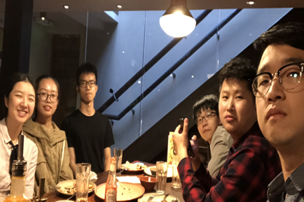
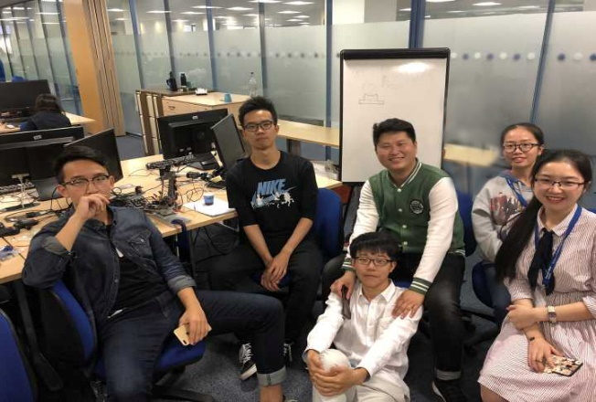
PART 4 TEAMWORK
Enjoy time together
GROUP 4 | Machine Learning, Robotics And Sensor Networks Summer School
08/2018

Slide 43

Thank You For Watching
GROUP 4 | 08/2018

